Slide 1
C Programming Language

Slide 2
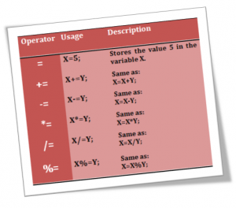
Operators
Arithmetic Operators
Assignment Operators
Relational Operators
Logical Operators
Bitwise Operators
Ternary Operator

Slide 3
Arithmetic Operators
Unary Operators ++ , --.
++ add one to it’s operand and – subtract one from it’s operand
int d=10;
d++; /* value of d will be 11 */
Postfix : x++ ; uses the original value of x in the equation, and then increments it afterword's.
Prefix: ++x ; increments x first, and then uses the new value of x inside the equation.
Example: x=10; y = x++ ; res: y=10 and x=11 as y=x; then x=x+1;
Example: x=10; y = ++x ; res y=11 and x=11 as x=x+1; then y=x;
Binary Operators + , - , * , / , % (remainder).
Operates on two operands as sum =num1 + num2; the two operands are num1 and num 2
If the two operands of / are int the result is int so the fraction part will be eliminated.
% modulus operator only operate with int operands and returns the remainder of division.
If the two operands are int the result is int.
If the two operands are float the result is float.
If one operand is int and the other is float the result is float.
+ , - have less precedence than *,/,%.
+,-,*,/,% are left associativity
++ ,-- have higher precedence than +,-,*,/,%.

Slide 4
Operators
Assignment Operators. = += -= *= /= %= &= |= ^= <<= >>=
x=y; means assign the value of y to x, so the value of x and y will be the same.
lvalue=rvalue assigns the right value ( can be constant or variable ) to the left value ( must be variable ),
x+=y means x=x+y, x*=y+1 means x=x*(y+1); and so on.
Relational Operators. == != < > <= >=
x==y means ask if x equal to y or not , the result is true or false.
False in c means 0 other values treated as true so values such as 1, 10 , -2 , -10 will be treated as true.
Logical Operators. ! && ||
Compare to relational expressions such as (a>b) && (b>c)
&& the result will be true only if the two operands are true otherwise the result is false.
|| the result is false only if the two operands are false otherwise the result is true.
Bitwise Operators.
& , | , ^
<< Left Shift
>> Right Shift
~ Complement.
Ternary Operator (Conditional Operator).
Variable = condition ? value when true : value when false ;

Slide 5

Operator precedence
The precedence of operators determines the order in which operations are performed in an expression. Operators with higher precedence are executed first. If two operators in an expression have the same precedence, associativity determines the direction in which the expression will be evaluated.
Unary ++,--
Multiplicative * , / , %
Additive + , -
Relational > >=,< , <=
Equality ==, !=
Logical AND &&
Logical OR ||
Assignment =
highest
Lowest

Slide 6
Control Statements
Conditional Statements
Switch Case statement
If Else
Loop Statements
For loop
While loop
Do While loop

Slide 7
Conditional Statements
These statements are used to have a program execute different statements depending on certain conditions. It makes a program “smarter” by allowing different choices to be made by the program.
In C, there are three conditional statements.
if execute a statement or not
if-else choose to execute one of two/more statements
Switch choose to execute one of a number of statements

Slide 8
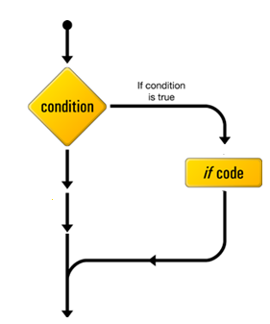
If Statement
The if statement allows branching (decision making) depending upon a condition. Program code is executed or skipped. The basic syntax is
if ( control expression ){
program statement;
}
If the control expression is TRUE, the body of the if is executed. If it is FALSE, the body of the if is skipped.
if (condition)
{
/*Some Logic If Code*/
}
/* other program code*/
To avoid dividing by zero
if( y!=0 )
z=x/y;
The statement z=x/y is executed only if y does not equal zero. If y=0 the z=x/y statement will not be executed.
Other program code

Slide 9
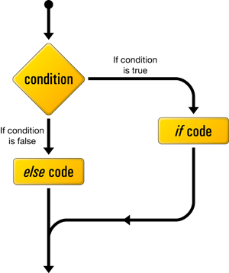
If-else Statement
Used to decide between two action. The syntax of the if-else statement is
if (expression)
statement1;
else
statement2;
The statement 1 is executed if expression is true otherwise statement2 is executed
if (condition)
{
/*Some Logic If Code*/
}
else{
/* else code */
}
/* other program code*/
To decide if a student succeeded or fail
if( degree>=60)
printf(“succeeded”);
else
printf(“fails”);
The succeeded word will be printed only if the degree of student is greater than or equal to 60. if the student degree less than 60 the fail word will be printed
Other program code

Slide 10
If-else if Statement
if (condition 1)
{
/*this code will be executed only if condition 1 true*/
}
else if(condition 2)
{
/*this code will be executed only if condition 1 false and condition 2 true */
}
else
{
/*if condition 1 and 2 are false
}
If we want to display the grade of student in a subject. The grade of student will be one of the following grade ( EX. , VG., G, A, F) according to his degree. In this situation we can use if-else if.
For example
if(i>0)
printf(“positive number”);
else if(i<0)
printf(“negative number”);
else
printf(“zero number”);

Slide 11
Switch-case statement
The switch statement is a alternative way of writing a program which employs an if-else if in condition that all condition are equality condition and data type to check is int or char.
char x;
switch (x) //switch expression may be int or char- float is not allowed
{
case 'a':
//Some Logic
break;
case 'b':
//Some Logic
break;
case 'c':
//Some Logic
break;
default:
//Some Logic
break;
}
The syntax for the switch statement is as follows:
switch (integer expression) {
case constant1:
statement1;
break;
case constant2:
statement2;
break;
...
default:
statement;
}

Slide 12
Switch-Case statement
The switch statement works as follows
1 Integer control expression is evaluated.
2- A match is looked for between this expression value and the case constants. If a match is found, execute the statements for that case. If a match is not found, execute the default statement (if present).
3- Terminate switch when a break statement is reached.
- Case constants must be unique (How to decide otherwise?)
– case constants must be simple constant.
– switch statement only tests for equality
–The control expression can be of type character since characters are internally treated as integers

Slide 13
Switch-Case statement
The statement break should be included at the end of each case statement. In general, whenever a statement is encountered in C, it interrupts the normal flow of control. In the switch statement, it causes an exit from the switch. If the break statement does not exists a fall through to the next case happens. The default clause is optional. The right brace at the end marks the end of switch statement
char x;
switch (x)
{
case 'a':
/* no break. It will fall through to the next case b*/
case 'b':
//Some Logic
break;
}
char x;
switch (x)
{
// case grouping
case 'a':
case ‘A':
//Some Logic
case 'b'
//Some Logic
break;
}

Slide 14
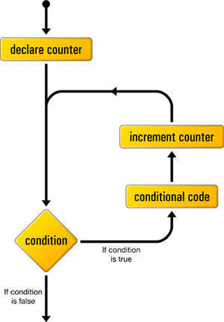
For Loop
The for loop is used to execute statements number of times according to a counter.
for example the following code will print hello world 5 times.
for( counter=0; counter<5; counter++)
{
printf(“hello world”);
}
The operation of the for loop is as follows
1- The initialization expression (declaration) is evaluated.
2- The test condition is evaluated. If it is TRUE, the body of the loop is executed. If it is FALSE, exit the for loop.
3- Assume test condition is TRUE. Execute the program statements making up the body of the loop.
4- Evaluate the increment expression and return to step 2.
5- When test condition is FALSE, exit loop and move on to next line of code.
Notes:
Note:But its apply only on objects that implement collection pattern

Slide 15
For Loop
The for loop is used to execute statements number of times according to a counter for example the following code will print hello world 5 times.
for( counter=0; counter<5; counter++)
{
printf(“hello world”);
}
2
for ( ; ; )
{
//Some Logic
}
// some logic
1
4
TRUE
3
False
5
Notes:
Note:But its apply only on objects that implement collection pattern

Slide 16
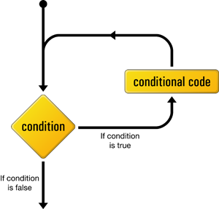
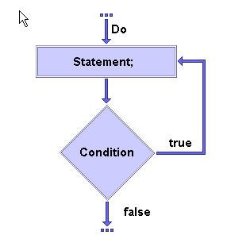
While Loop & Do While Loop
while (condition)
{
//Some Logic
}
do
{
//Some Logic
} while (condition);
Notes:
Note:But its apply only on objects that implement collection pattern

Slide 17
Lab.
1- simple menu with three choices ( new , display , exit ).
Inputs: n,d or e Characters
Output:
- if user enters n PRINT New and continue accepting new character,
- if he enters d PRINT Display and continue accepting new character,
- if he enters e print EXIT and exit from program
2-print grade of a student.
Input: degree between (0 & 100)
Output:
- if degree between 90 and 100 print Excellent.
- if degree between 80 and 90 print verygood.
- if degree between 70 and 80 print good.
- if degree between 60 and 70 print Acceptable.
- if degree between 0 and 60 print Fail.
3- receive numbers from the user and exit when sum exceeds 100.
4- magic box.
Notes:
Note:But its apply only on objects that implement collection pattern

Slide 18
Lab.
3- receive numbers from the user and exit when sum exceeds 100.
Inputs: continue inserting numbers until there sum exceeds 100
Output: sum
4- magic box ( to be explained )
Notes:
Note:But its apply only on objects that implement collection pattern

Slide 19
Home.
1- prime number
Input : number n
Output: print if it is prime or not
Example:
i/p: 7 – o/p => prime.
i/p: 8 – o/p => not prime.
2- print prime numbers until specific number
Input : number n
Output: print all prime numbers until n.
Example:
i/p : 7 – o/p => 2, 3 , 5 , 7
i/p : 20 – o/p => 2, 3 , 5 , 7 , 11 , 13 , 17 , 19
Notes:
Note:But its apply only on objects that implement collection pattern

Slide 20


